Slide 1

Trend Trading:
The Implementation of Kalman Filter in Equity Market
QF621 Quantitative Trading Strategies
BAI Chen / WANG Yunxiang / WEN Chongji / ZHANG Penghui
http://www.free-powerpoint-templates-design.com

Slide 2
Overall
Introduction
Introduction & Methodology
WANG Yunxiang
Model Development & Performance Comparison
BAI Chen
Model Extension: Adding Assistance Indicators
WEN Chongji
Summary & Future Extension
ZHANG Penghui

Slide 3
Introduction & Methodology

Slide 4
Trend Based Trading Strategy
Pros and Cons of Common Indicators Used to Define Trends:
Pros
Pros
Subjective Flexibility
Simple yet informative
Incorporates both momentum and trend
Takes out some lags by using exponential moving average
No clear guide on length of rolling window
Cons
Cons
Lagging Indicator
Subjective flexibility
Prone to false signals
Lagging indicators
Short-term
Lagging indicators
The trend is already there when signal comes
MA
MACD
Moving Average
Moving Average
Convergence/Divergence

Slide 5
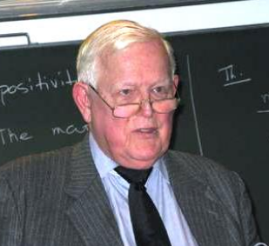
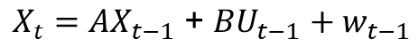
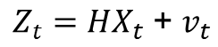
Kalman Filter
A Recursive Solution To Predict The State of Noisy Systems
The Process to be estimated:
$$X_{t}{ : }^{′}True^{′} State (′True^{′} price of stock)$$
$X_{t}={AX}_{t−1} \text{+} {BU}_{t−1}$ ${+ w}_{t−1}$
w ~ N(0, Q)
With a measurement:
$$Z_{t}:Measurement ofX_{t} (Market observed price)$$
$$Z_{t}={HX}_{t} \text{+} v_{t}$$
v ~ N(0, R)
(w & v are independent)
1960
Present
NASA’s Apollo project
Estimated the trajectories of spacecraft
Engineering
Econometrics & Finance
Autopilot, Satellite Navigation, …
Rudolf Emil Kálmán
(1930 – 2016)

Slide 6
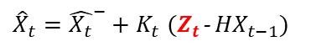
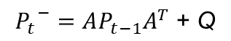
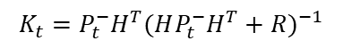
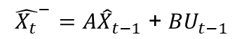
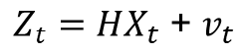
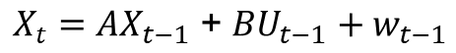
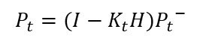
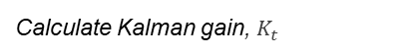
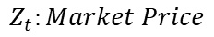
Kalman Filter
A Recursive Solution To Predict The State of Noisy Systems
Project Forward
Time step (t-1) to (t)
Measurement Update
At Time step (t)
Time Update: “Predict”:
Calculate Kalman gain, $K_{t}$
Filter Initial Input
$$K_{t}=P_{t}^{−}H^{T}{(HP_{t}^{−}H^{T}+R)}^{−1}$$
$${\hat{X_{t}}}^{−}=A{\hat{X}}_{t−1} \text{+} {BU}_{t−1}$$
Prediction Update
Estimate Error Covariance:
${\hat{X}}_{t}={\hat{X_{t}}}^{−}+K_{t}$ $(Z_{t}$- ${HX}_{t−1})$
$$Z_{t}:Market Price$$
Estimate Error Covariance:
$${P_{t}}^{−}=AP_{t−1}A^{T} \text{+} \text{Q}$$
$$P_{t}=(I−K_{t}H){P_{t}}^{−}$$
$X_{t}={AX}_{t−1} \text{+} {BU}_{t−1}$ ${+ w}_{t−1}$
$$Z_{t}={HX}_{t} \text{+} v_{t}$$
w ~ N(0, Q)
v ~ N(0, R)

Slide 7
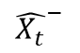
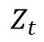
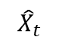
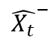
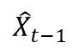
Kalman Filter
A Recursive Solution To Predict The State of Noisy Systems
Project Forward
Time step (t-1) to (t)
Measurement Update
At Time step (t)
$$Z_{t}$$
Filter Initial Input
$${\hat{X}}_{t−1}$$
$${\hat{X_{t}}}^{−}$$
$${\hat{X}}_{t}$$
$${\hat{X_{t}}}^{−}$$

Slide 8
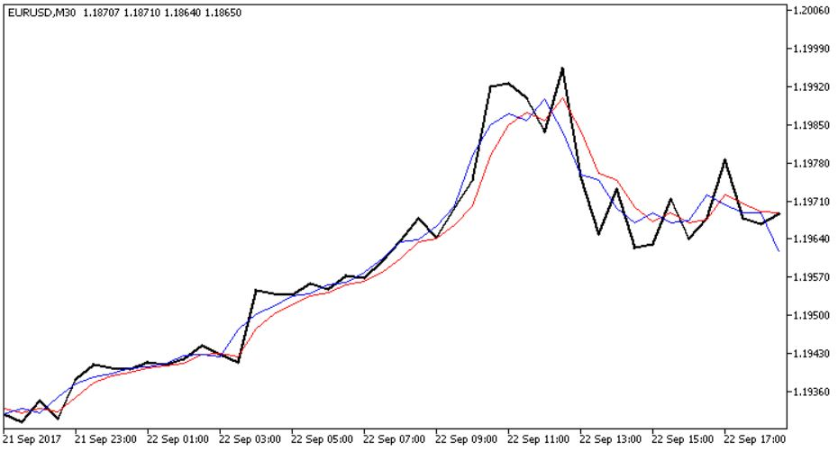
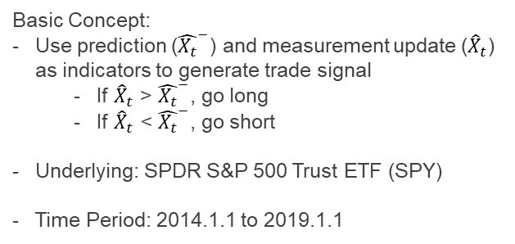
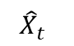
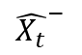
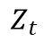
Trading Strategy
With Kalman Filter
$$Z_{t}$$
$${\hat{X_{t}}}^{−}$$
$${\hat{X}}_{t}$$
Basic Concept:
Use prediction (${\hat{X_{t}}}^{−}$) and measurement update (${\hat{X}}_{t}$) as indicators to generate trade signal
If ${\hat{X}}_{t}$ > ${\hat{X_{t}}}^{−}$, go long
If ${\hat{X}}_{t}$ < ${\hat{X_{t}}}^{−}$, go short
Underlying: SPDR S&P 500 Trust ETF (SPY)
Time Period: 2014.1.1 to 2019.1.1
Long
Short

Slide 9
Model Development & Performance Comparison

Slide 10
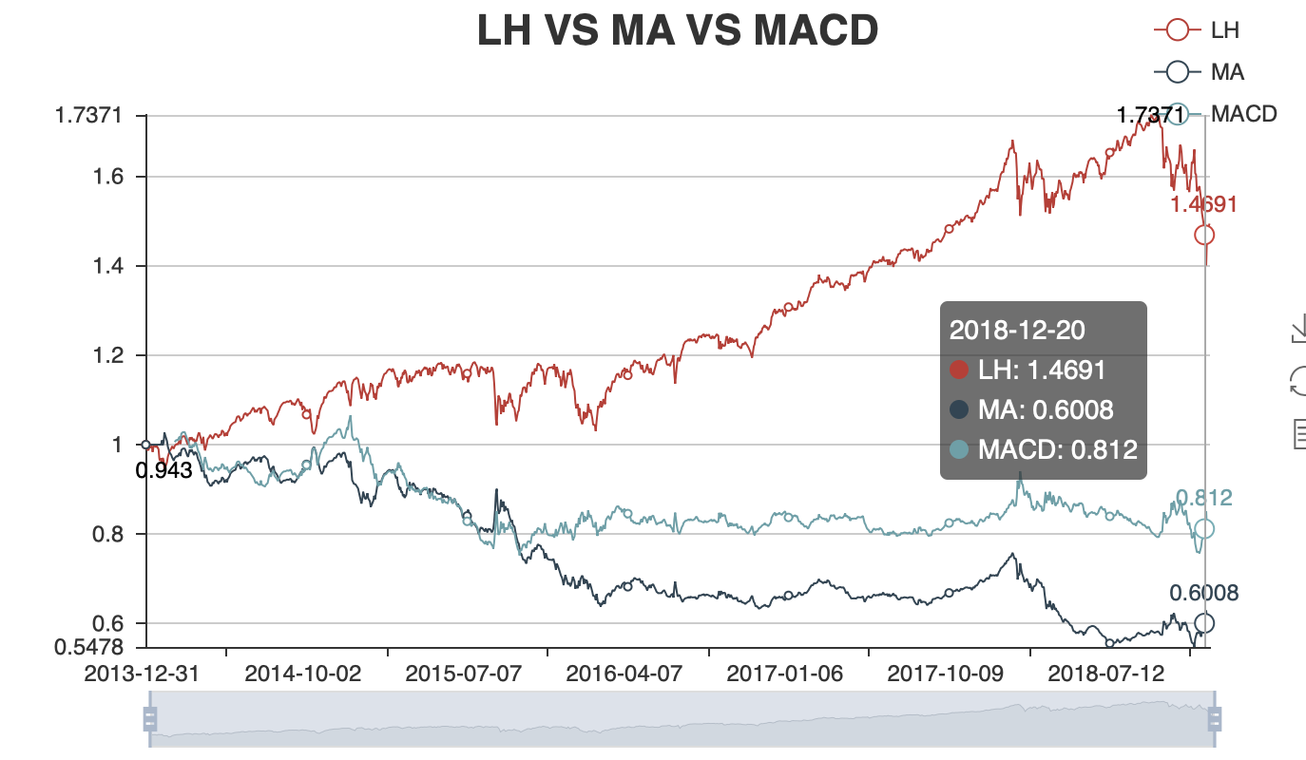
Model 0
Benchmark Performance
 | Long & Hold | SMA | MACD
Net value | 1.49 | 0.59 | 0.80
Annualized return | 8.84% | -9.67% | -3.81%
Annualized volatility | 13.14% | 13.05% | 13.14%
Sharpe ratio | 0.67 | -0.74 | -0.29
Maxdrawdown | 19.35% | 46.68% | 29.42%
Winning rate |  | 30.88% | 20.45%
Trading times |  | 68 | 132
p&l ratio |  | 0.48 | 0.73

Slide 11
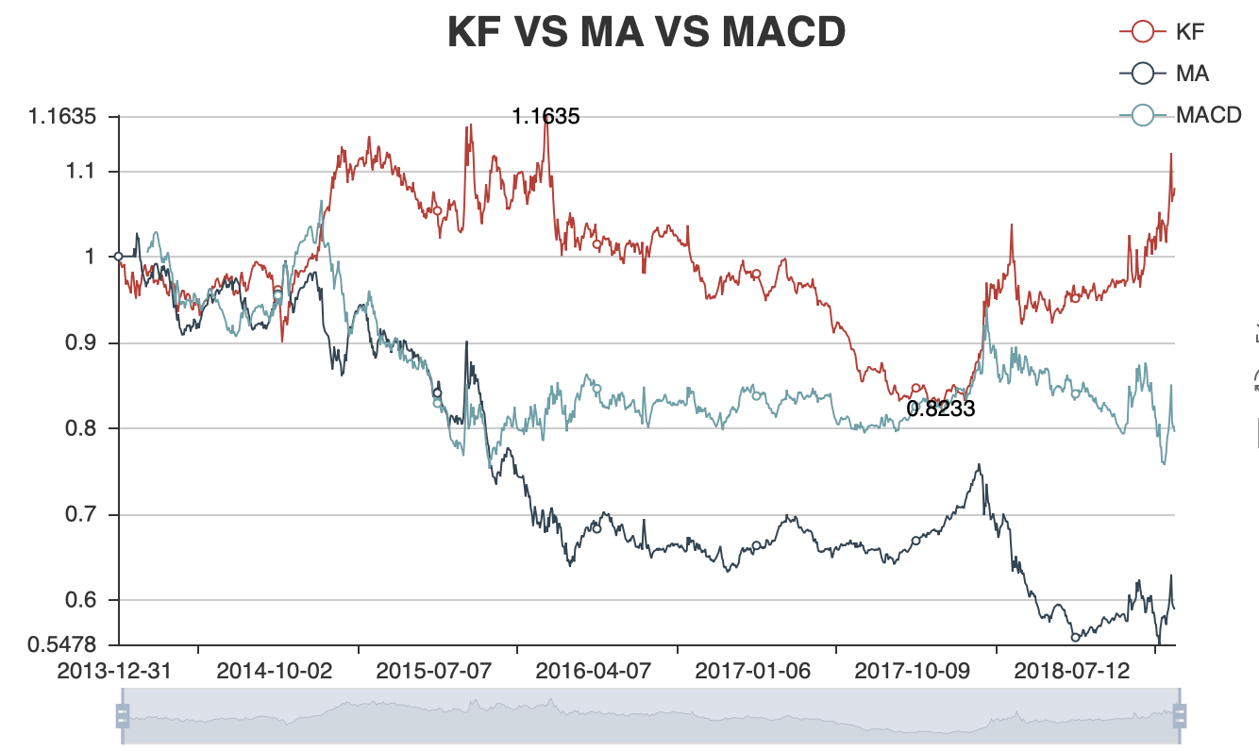
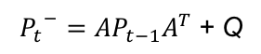
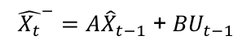
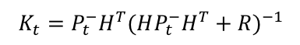
Model 0
Kalman Filter Initialization
$${\hat{X_{t}}}^{−}=A{\hat{X}}_{t−1} \text{+} {BU}_{t−1}$$
$${P_{t}}^{−}=AP_{t−1}A^{T} \text{+} \text{Q}$$
$$K_{t}=P_{t}^{−}H^{T}{(HP_{t}^{−}H^{T}+R)}^{−1}$$
Set A =1, B =0, Q=1,R=1, H=1
 | KF | SMA | MACD
Net value | 1.08 | 0.59 | 0.80
Annualized return | 2.39% | -9.67% | -3.81%
Annualized volatility | 13.15% | 13.05% | 13.14%
Sharpe ratio | 0.18 | -0.74 | -0.29
Maxdrawdown | 29.24% | 46.68% | 29.42%
Winning rate | 33.33% | 30.88% | 20.45%
Trading times | 435 | 68 | 132
p&l ratio | 1.07 | 0.48 | 0.73

Slide 12
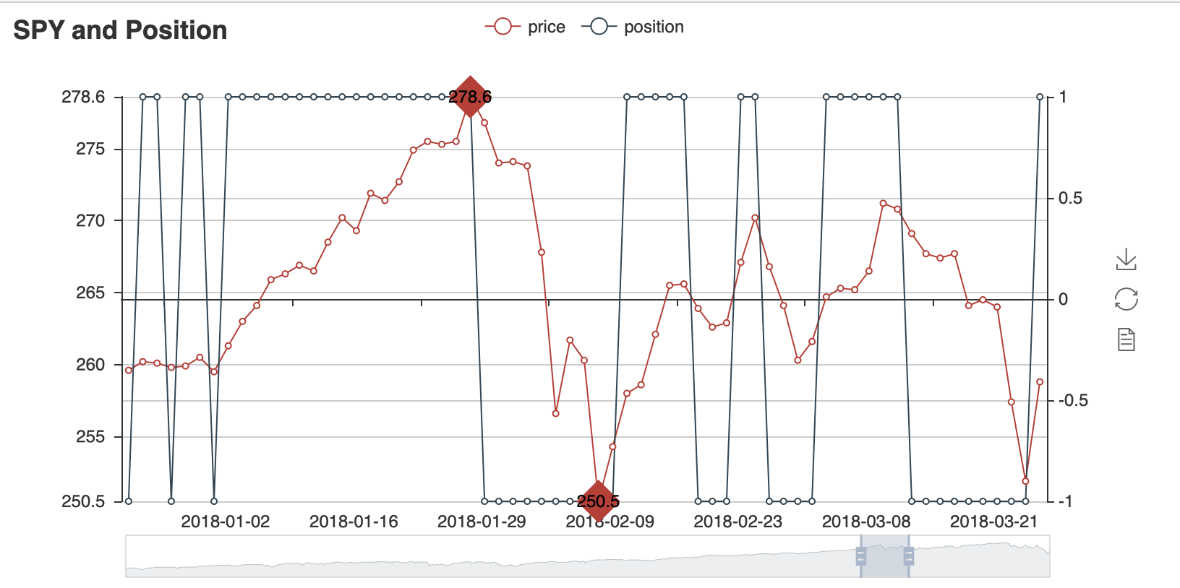
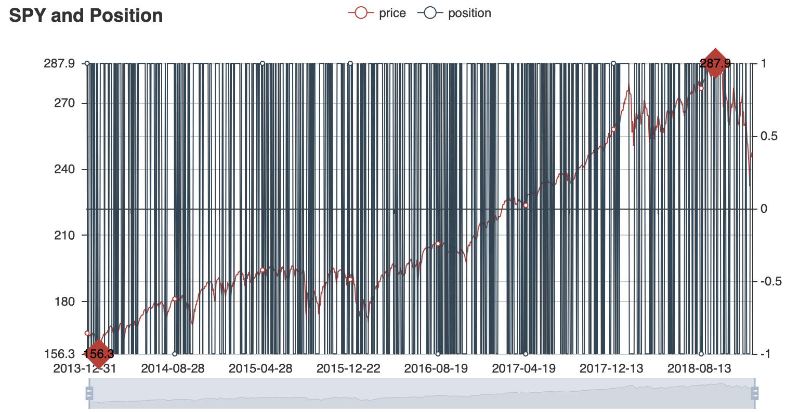
Model 0
Kalman Filter Initialization
Pros
Grab the trend fast
Cons
Too sensitive

Slide 13
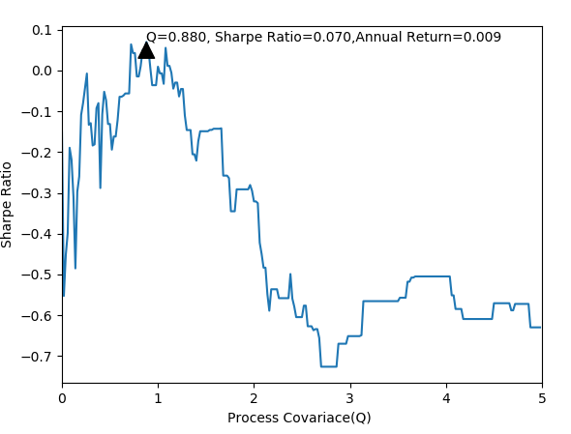
Model 1
Optimization
with Process Covariance (Q)
Split the sample to train and test with 60% and 40% each.
Recall parameter Q is Process
Covariance in Kalman Filter
Q is a subjective input parameter

Slide 14
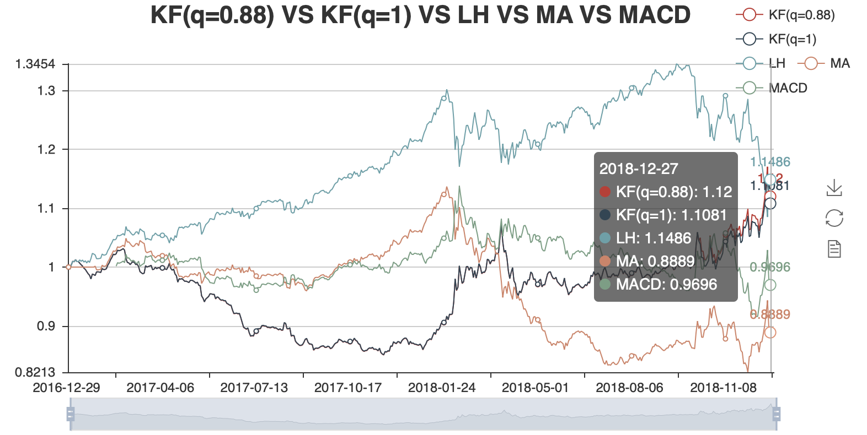
Model 1
Optimization
with Process Covariance (Q)

Slide 15
Model 1
Optimization
with Process Covariance (Q)
ratio | KF (q =0.88) | KF (q =1) | Long & Hold | SMA | MACD
Net value | 1.13 | 1.12 | 1.16 | 0.88 | 0.96
Annualized return | 6.83% | 6.30% | 8.08% | -5.39% | -1.17%
Annualized volatility | 12.91% | 12.91% | 12.89% | 12.83% | 13.25%
Sharpe ratio | 0.53 | 0.49 | 0.63 | -0.42 | -0.09
Maxdrawdown | 17.54% | 17.49% | 19.35% | 27.76% | 19.52%
Winning rate | 31.95% | 31.58% |  | 29.17% | 17.14%
Trading times | 169 | 171 |  | 24 | 70
p&l ratio | 1.26 | 1.23 |  | 0.59 | 0.74
Poor Performance
More Extensions

Slide 16
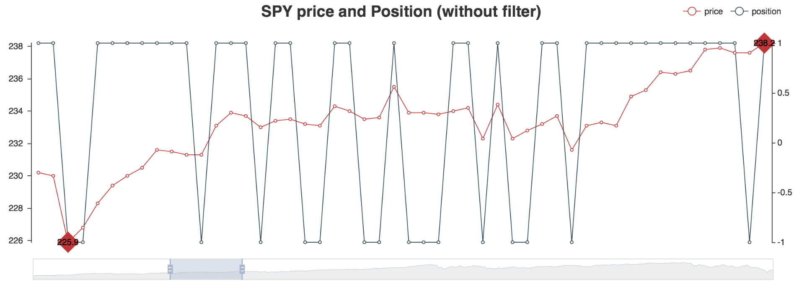
Model 2
Ranging Aversion
High frequencies
Commission fee
Invalid Signals
Low performance

Slide 17
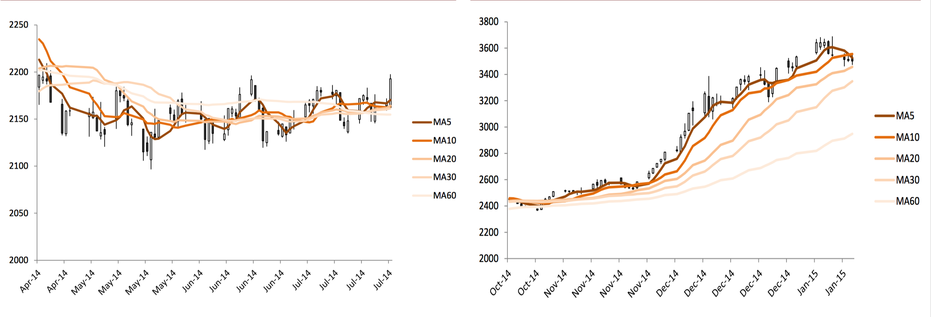
Model 2
Differentiation
Moving Average Crossover
Ranging Market
Trending Market

Slide 18
Model 2
Differentiation
Spearman’s Rank-order Coefficient
Position | Order | Rank Coefficient
MA5
MA10
MA20
MA30
Long Position
Spearman(L P, L P) = 1
MA30
MA20
MA10
MA5
Short Position
Spearman(L P, S P) = -1

Slide 19
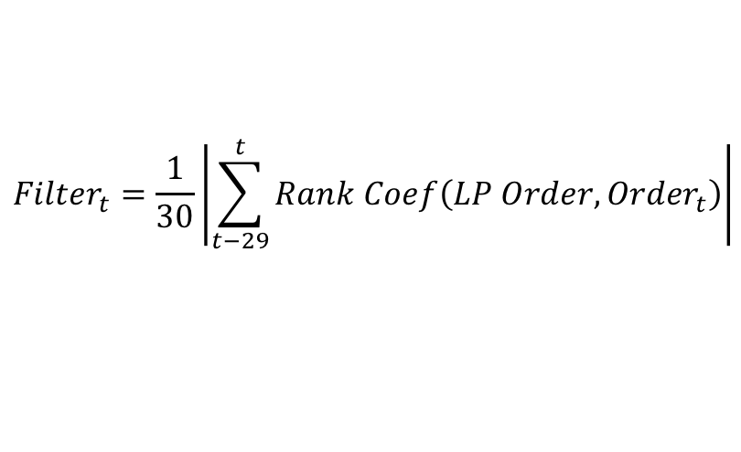
Model 2
Differentiation
Trend Filter
$${Filter}_{t}=\frac{1}{30}\left|\sum_{t−29}^{t}{Rank Coef\left(LP Order, {Order}_{t}\right)}\right|$$
When Filter is large, it means there is a trend much stronger than the other trend
Date | Adj Close | Return | MA5 | MA10 | MA20 | MA30 | Order | Rank C | Filter
19/11/18 | 265.075195 | -0.01691 | 267.55 | 270.40 | 267.95 | 269.80 | MA10, MA30, MA20, MA5 | -0.4 | 0.686667
20/11/18 | 260.169647 | -0.01851 | 265.99 | 269.31 | 267.48 | 269.04 | MA10, MA30, MA20, MA5 | -0.4 | 0.686667
21/11/18 | 261.056183 | 0.003408 | 264.97 | 267.74 | 267.47 | 268.60 | MA30, MA10, MA 20, MA5 | -0.8 | 0.686667
23/11/18 | 259.312683 | -0.00668 | 263.04 | 266.04 | 267.13 | 268.31 | MA30, MA20, MA 10, MA5 | -1 | 0.693333

Slide 20
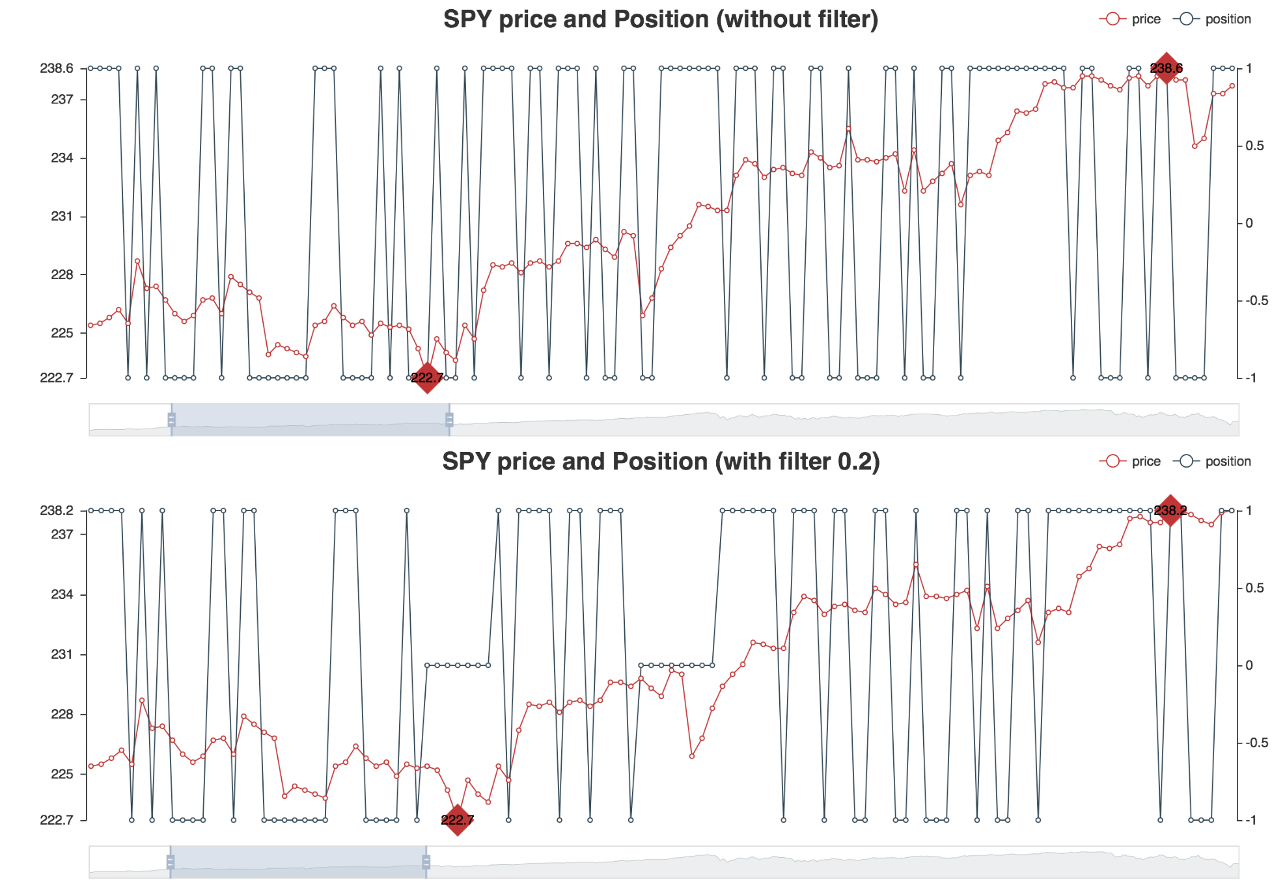
Model 2
Comparison
Ratio | KF
Net value | 1.128366
Annualized return | 0.068339
Sharpe ratio | 0.529533
Ratio | KF + Trend Filter
Net value | 1.24517
Annualized return | 0.115439
Sharpe ratio | 1.016026
Trending Market

Slide 21
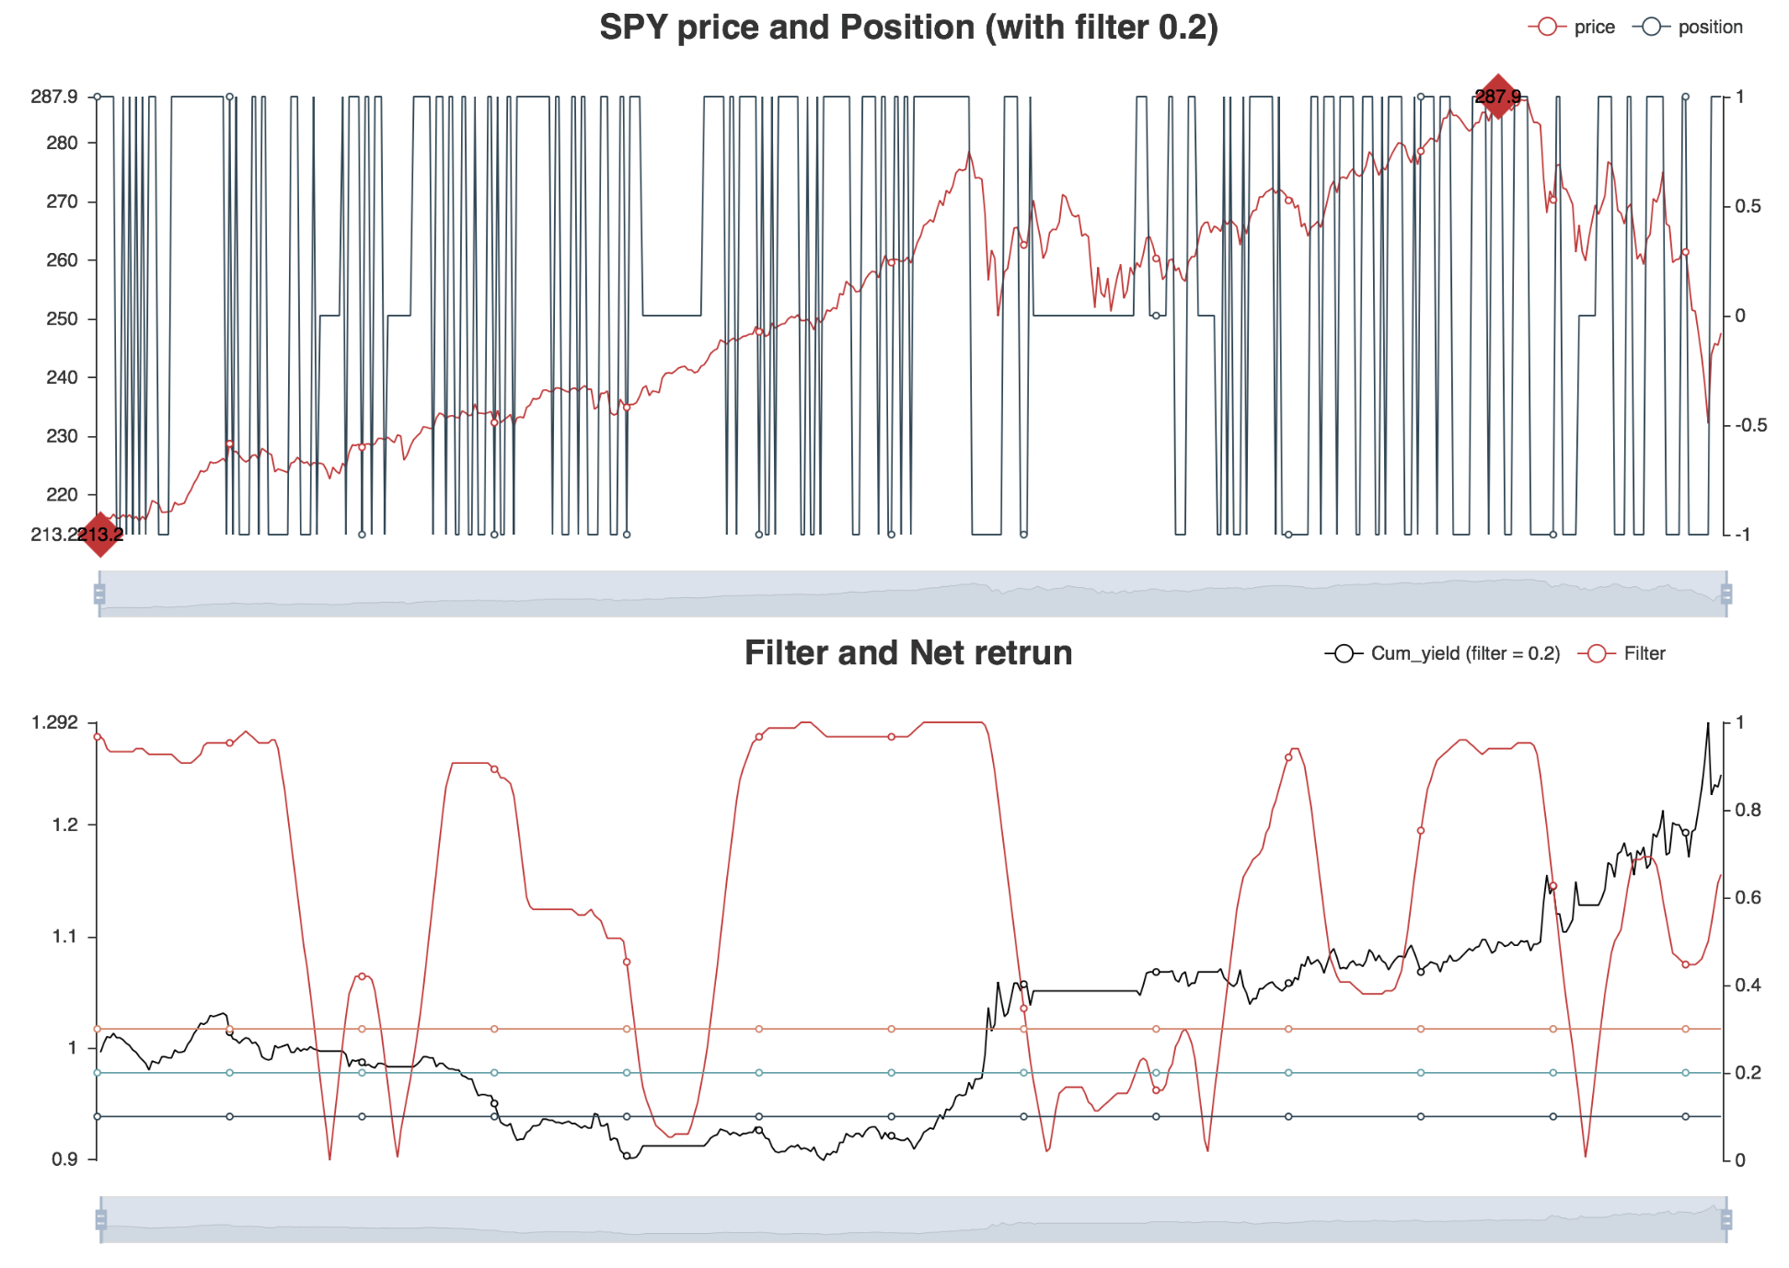
Model 2
Trend Filter
Ratio | Filter = 0.1 | Filter = 0.2 | Filter = 0.3
Net value | 1.196001 | 1.24517 | 1.194902
Annualized reutrn | 0.096968 | 0.115439 | 0.094361
Annualized volatility | 0.126609 | 0.113618 | 0.108281
Sharpe ratio | 0.765881 | 1.016026 | 0.871444
Maxdrawdown | 0.146702 | 0.128011 | 0.142367
Winning rate | 0.337278 | 0.348993 | 0.326087
Trading times | 169 | 149 | 138
p&l ratio | 1.383156 | 1.611505 | 1.564914
Filter = 0.1

Slide 22
Summary & Future Extension

Slide 23
Summary
Ratio | Model 0 | Model 1 | Model 2
Net value | 1.12 | 1.13 | 1.19
Annualized reutrn | 6.30% | 6.83% | 9.44%
Annualized volatility | 12.91% | 12.91% | 10.83%
Sharpe ratio | 0.49 | 0.53 | 0.87
Maxdrawdown | 17.49% | 17.54% | 14.24%
Winning rate | 31.58% | 31.95% | 32.61%
Trading times | 171 | 169 | 138
p&l ratio | 1.23 | 1.26 | 1.56
Model 0
Sensitive Indicator
Model 1
Parameter Optimization
Model 2
Extension

Slide 24
Future Extension
Market: Stock market may not be a good universe
Data Frequency: High frequent data may be better
Additional Indicator needed: Too sensitive
Other Application: Kalman filter estimates hedge ratio in pair trading (which is not allowed in this project)

